Slide 1
HappyTravel
By Abu saleh md noman and sonali atram

Slide 2
Tourism & Technology
With the rapid growth of technology including websites, mobile apps, online travel agencies etc., modern travelers use tech­nology more than ever before.
Although latest travel search engines like Travelocity, Expedia and TripAdvisor make it easy to plan trips beforehand; we wanted to see how much influence it really has on deciding where to go and what type of experiences to get.

Slide 3
Existing Technology
Website and/or app | Purpose
SeatGuru | Pick a good seat in flight
Points.com | Track your status
Worldmate Gold | Keep track of itinerary
Hipmunk | Stay at desired holiday location
Priceline | Cheap booking and deals
TripAdvisor | Get other travelers review
Flight+ | Track your flight
Google maps | Navigate the roads
Roadtrippers | Plan roadtrips
Expedia | Plan trip and booking in advance

Slide 4
Initial Approach
Interview at least 15 travelers
Create a survey based on those interviews
Analyze Data
Provide some sort of prototype or solution
Usability testing
Notes:
In HappyTravel project we have interviewed travelers to learn and understand the thought process behind choosing a particular location to visit and its influencing factors.
20 travelers
By conducting comprehensive interviews and survey, we have analyzed traveler’s responses about existing systems and whether there is a need for more information.
We will create a wireframe for a website portal which will be evaluated by a group of travelers.

Slide 5
Participants Recruitment
We interviewed 20 travelers – Open ended interviews
Travelers who travel at least 3 to 4 times a year
Travel with Family and Friends
Kids range from ages 2-18
We had two surveys created and posted on social media
First Survey: 100 respondents
Second Survey: 25 respondents

Slide 6
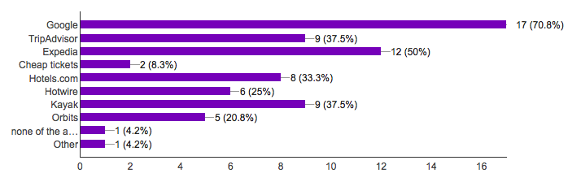
FINDINGS
Repeated Responses:
When making travel arrangements which of the following do you use?

Slide 7
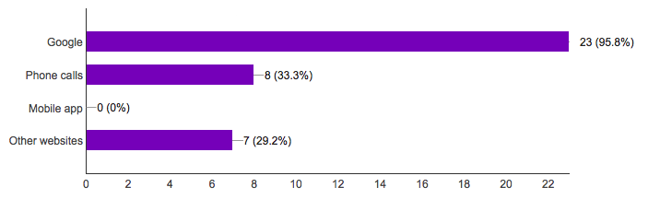
FINDINGS
Repeated responses:
When planning a vacation/travel how do you gather information about the place?
From the interviews:
Most people we interviewed use google as a initial start to gather information about their travel.

Slide 8
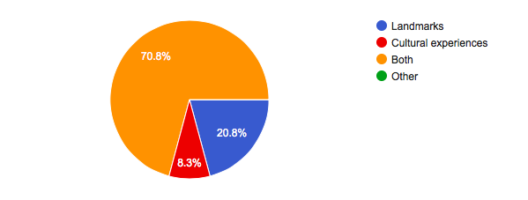
FINDINGS
Repeated Responses:
When traveling do you visit landmarks or looking for cultural experiences?
From the interviews:
“ We like to see the landmarks and get the cultural experience too. Both are equally important to us.”
“ I personally like to get more cultural experience but for my kids visiting famous landmarks and taking picture with them makes them remember the places.”

Slide 9
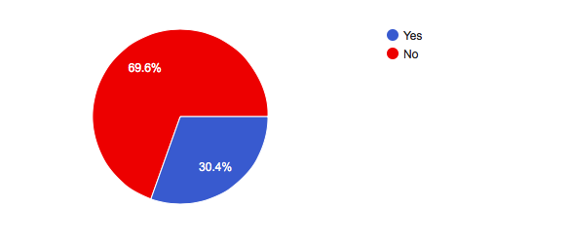
FINDINGS
Repeated Responses:
Have you ever been influenced by websites or advertisements on web to visit the place?

Slide 10
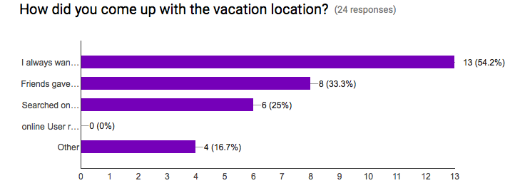
FINDINGS

Slide 11
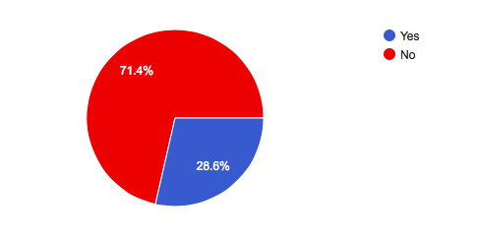
FINDINGS
Is there anything you would like to see online that will help you get more satisfying travel experience?

Slide 12
Over all travelers look OK with the current technologies available
☺

Slide 13
Interview Analysis
Most travelers we talked are families with young kids from ages 2 -18.
Families wanted to find family friendly places easily.
Currently travelers use blogs by other travelers.
Few clicks on Google to search for multiple places and reviews does not bother travelers.
BUT

Slide 14
What we propose:
Users don’t always know what they want
So we propose
Creating a prototype of family oriented travel search

Slide 15
On the scale of 1-5 please provide feedback on prototype on the comment section of the review

